Slide 1

The American Media Attack On Saudi Arabia Over Khashoggi's Death
Name:
Tutor:
Institution:

Slide 2
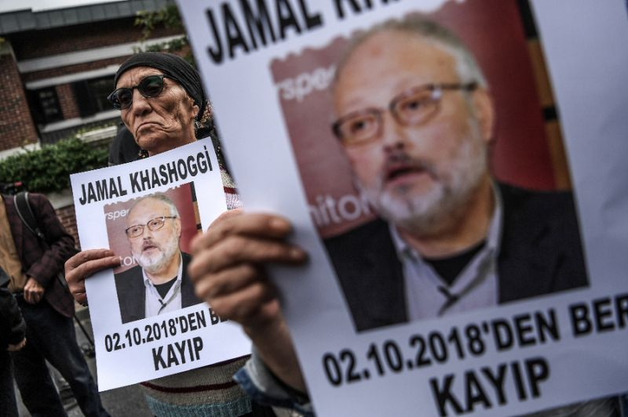
INTRODUCTION
Saudi Arabia has been subjected to a wave of fierce attack from major western media outlets.
This attack, comes after news of the killing of the Saudi journalist Jamal Khashoggi.
The killing stains reputation of the Saudi government and people

Slide 3


Karen Attiah uses a way of discourse with the involvement of specific ideological or political agenda that create particular versions of the world .
words like 'journalists' and 'consulates' , indirectly deforms the reputation of Saudi Arabia‘.
In that, the deah of Khashoggi is usual and practiced regularly on behalf of the Saudi government.
"It’s easy to get lost in the grief and outrage over Trump siding Saudi regime that thinks nothing of butchering peaceful journalists in consulates. But hope is not all lost. Congress must act, and the American people can still help.”

Slide 4

“Congress must investigate Trump’s and Jared Kushner's financial dealings with Saudi Arabia and Mohammed bin Salman and resulting conflicts of interest. MbS once reportedly bragged about having Kushner “in his pocket”"
Political players invest in all what could be of benefit to gain public sympathy and better political position.
Attiah describes the incidence non politically.
She implies that Trump and Kushner have personal financial relations in Saudi Arabia, Russia and other countries and may be at odds with the national interest of the United States and the American people.

Slide 5
"There is talk that the Saudis may choose a woman ambassador (Princess Reema) to come to Washington. Women shouldn’t be used to whitewash brutality especially as long as Saudi Arabia is jailing, torturing, + sexually abusing women’s rights activists."
The tweet is in support of feminism and women's rights movements .
the struggle to improve women's conditions even in Western societies is real.
However, always been a ground for pure political conflict as well as discourse exchange.
Attiah, neglects the recently-made efforts by the Saudi government regarding women's rights.
By starting the tweet with mere rumors, she jumps to virtual defending of women to portray the Saudi government as brutal one which is in favor of using women to its own ends,

Slide 6

"As a black woman, I am tired of seeing black, brown and Arab bodies treated as disposable by violent state agents. We shouldn't be choked to death on New York sidewalks. Or strangled and dismembered in consulates."
He tweet depicts that social and racial tensions of the American history are deployed without any regard to their right context
Attiah here refers to the death of Eric Garner, black American man killed by policemen in a case of police brutality.
This text seeks to establish a sort of social solidarity Donald Trump, expressed hostility and contempt his political campaign for the presidency

Slide 7
Conclusion
It is evident that modern western culture celebrates new technology and aligns itself with cyber patterns of discourse as in social media platforms.
Social media is the new outlet for commercial products with entities to make revenue from them.
Media has been so effective in cultural transformations to the point that Heidegger pessimistically referred to it as ‘world as picture’ .
The lack of and the need for professional and organized media counter-attack effort on the global level has contributed dramatically in placing Saudi Arabia in a compromising position.

